Slide 1
Open Source for Navigation
Xun(Perry) Liu
4/10/2019

Slide 2
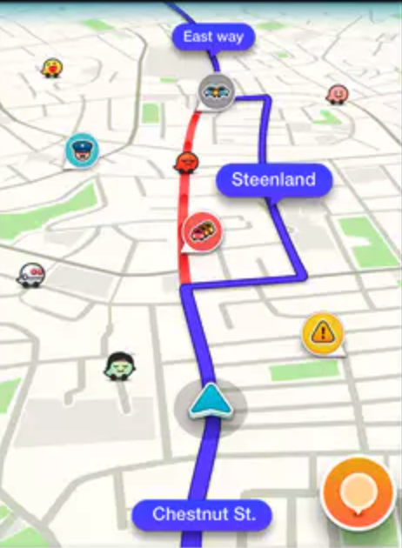


Agenda
How to organize mapdata for map streaming
Calculate route consider dynamic information
Map Matching when the map data is wrong
Notes:
Calculate route consider dynamic information

Slide 3

Story #1. How to organize mapdata for map streaming
What is map streaming
Off-line navigation
Regional Extracts
Cacheability/Updateability

Slide 4
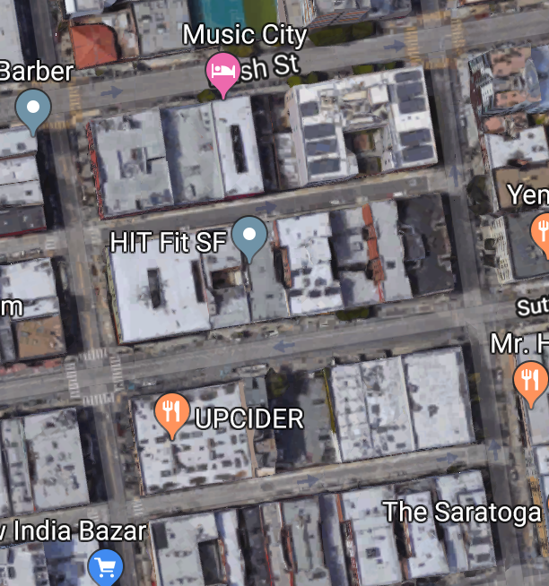
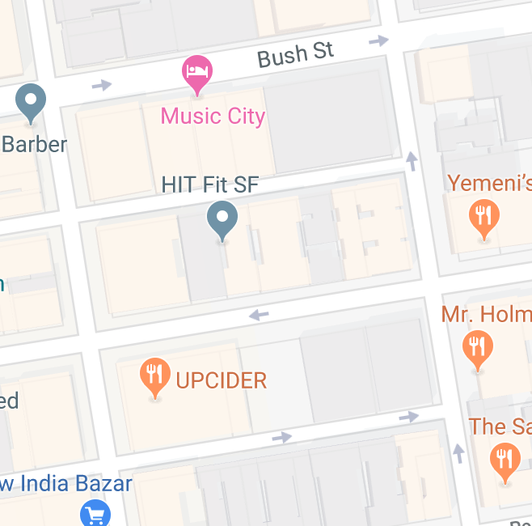
Terminology
Node
Tile1
End
Shortest Path
Tile2
Edge
Start
Graph
Notes:
The original picture tells the feature of destination adjustment from Lyft

Slide 5
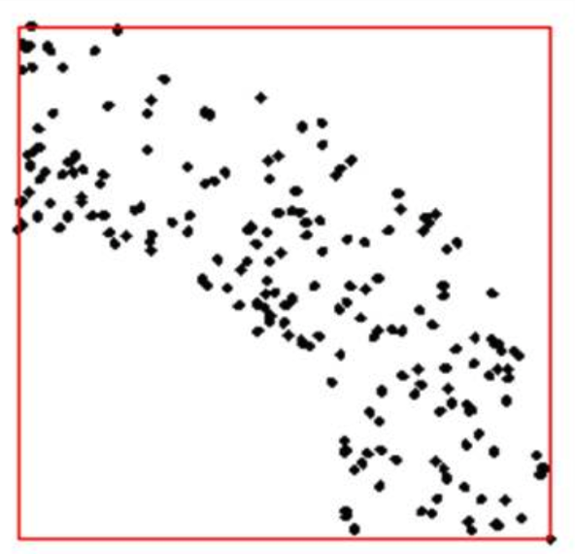
How to store data
How UBER find nearest rider for you?
Find k-th nearest element
Read only needed data
Balanced file size
Notes:
Add current data statistics

Slide 6
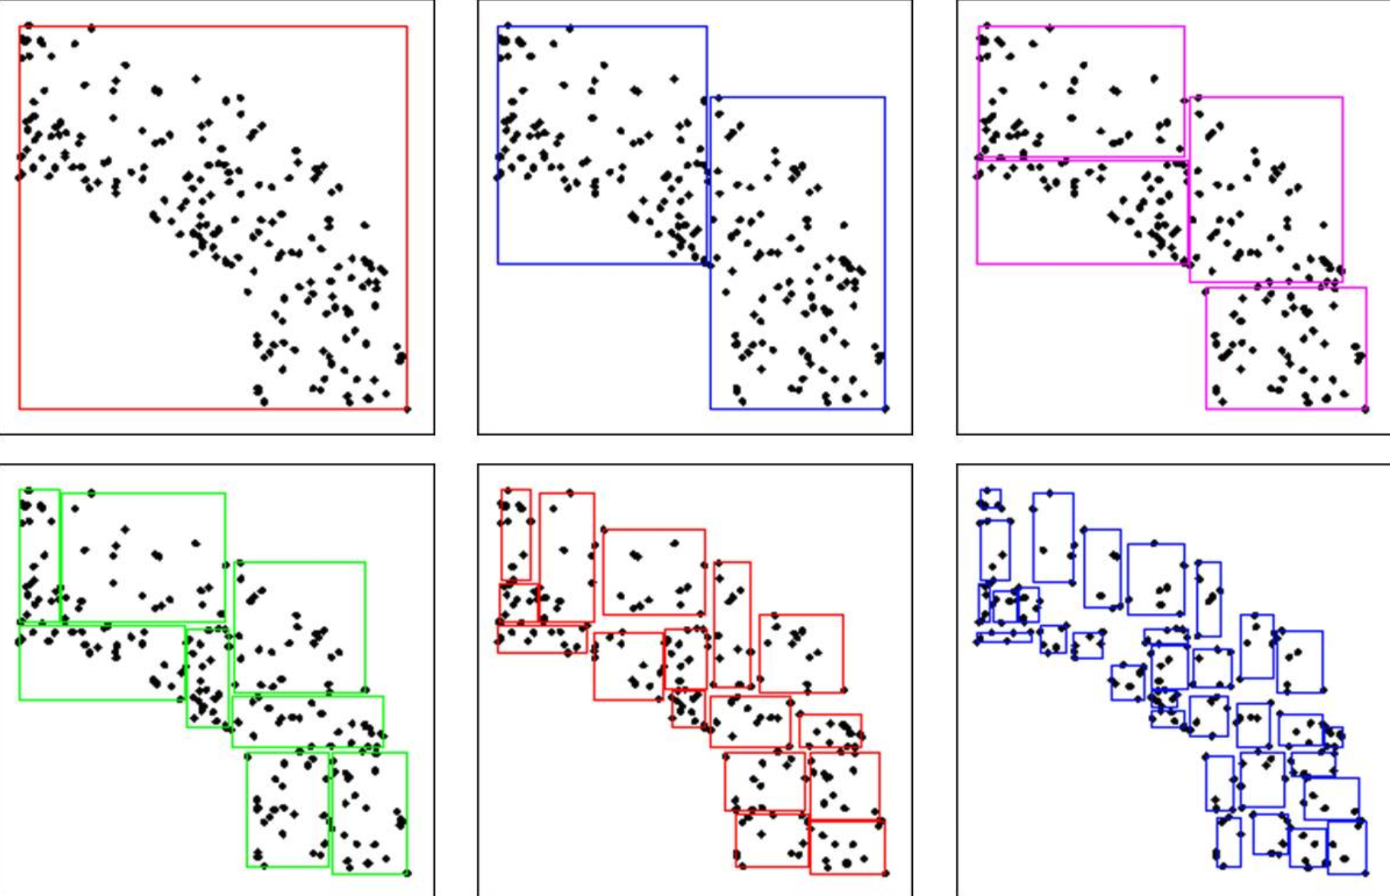
KD split
Average count is 2000~3000
Average file size is 700KB
Easy to implement
Element might move to different tile during data update
Need additional meta data
Notes:
Add current data statistics

Slide 7
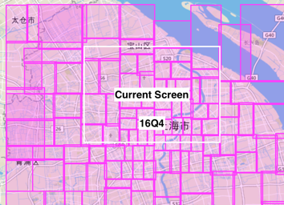
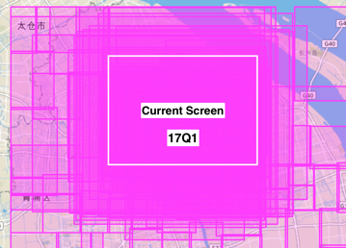
History Issue
16Q4
17Q1
Notes:
Add current data statistics

Slide 8
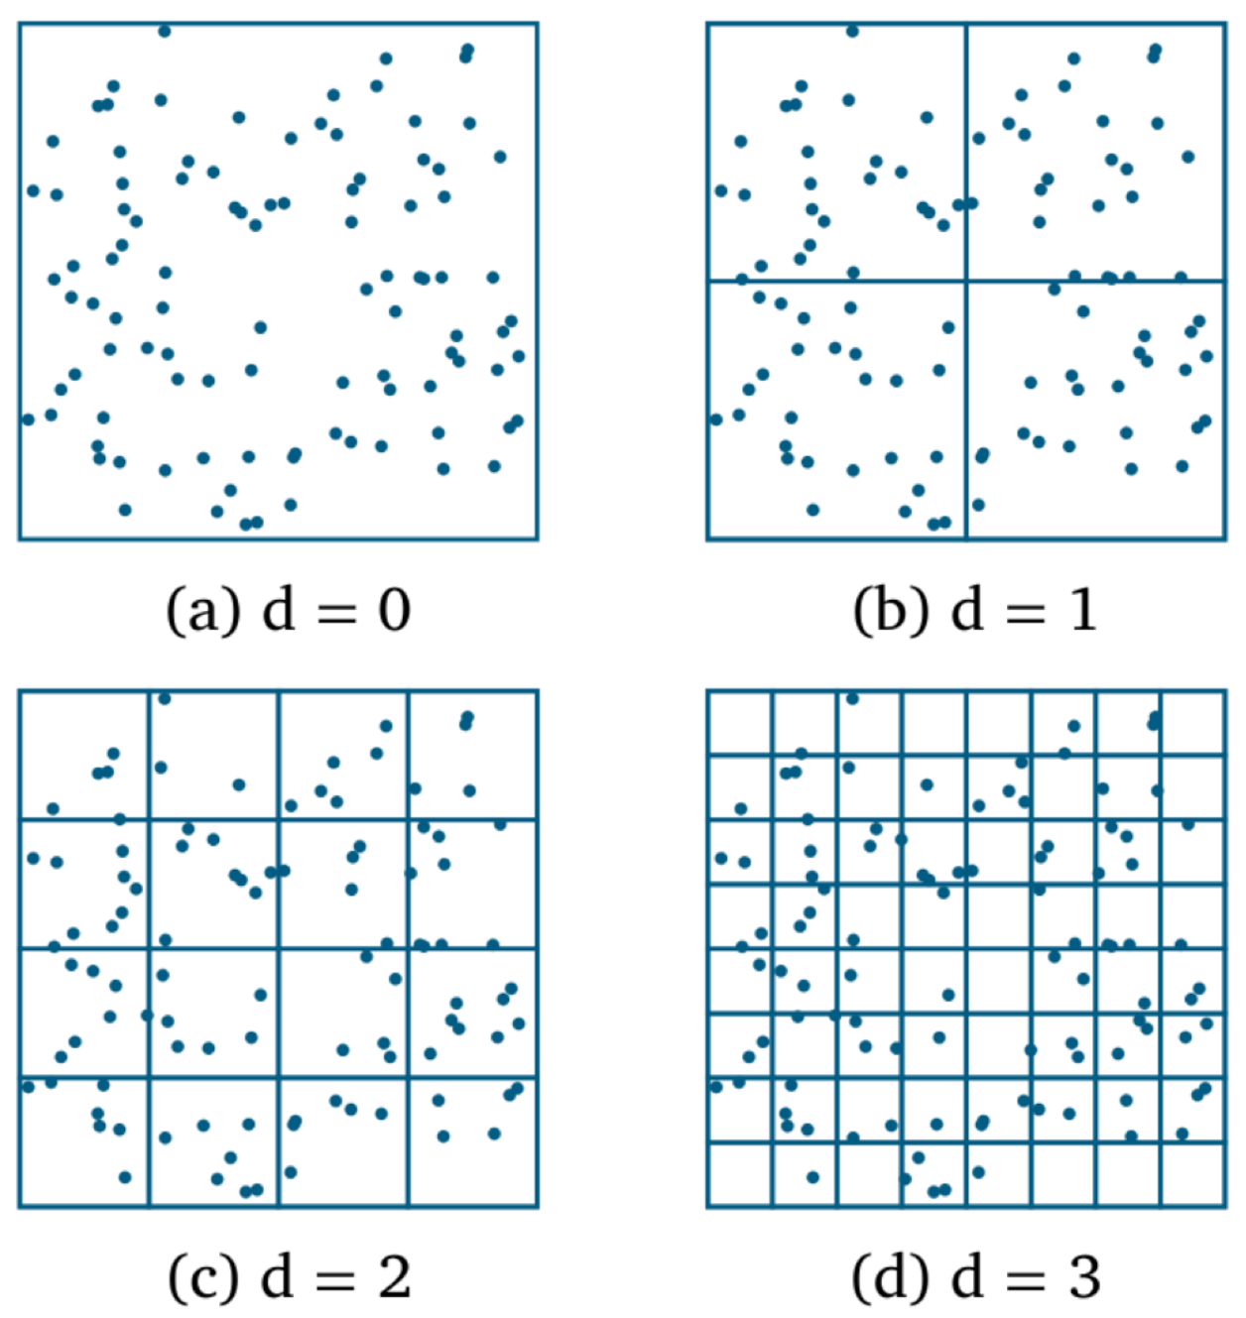
Keep data element stable/Get tileid by latlon
Fixed boundary split
Element will stay in fixed grid as long as no change for geometry
Grid id could be calculated by lat/lon
Cacheability/Updateability
File size depend on data density

Slide 9
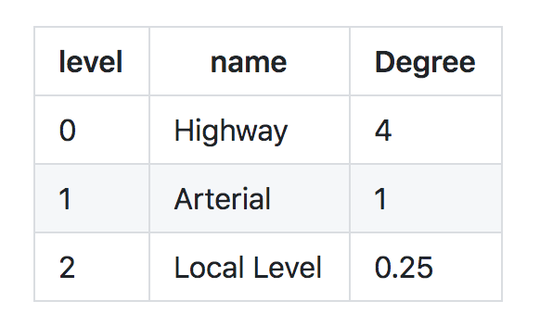
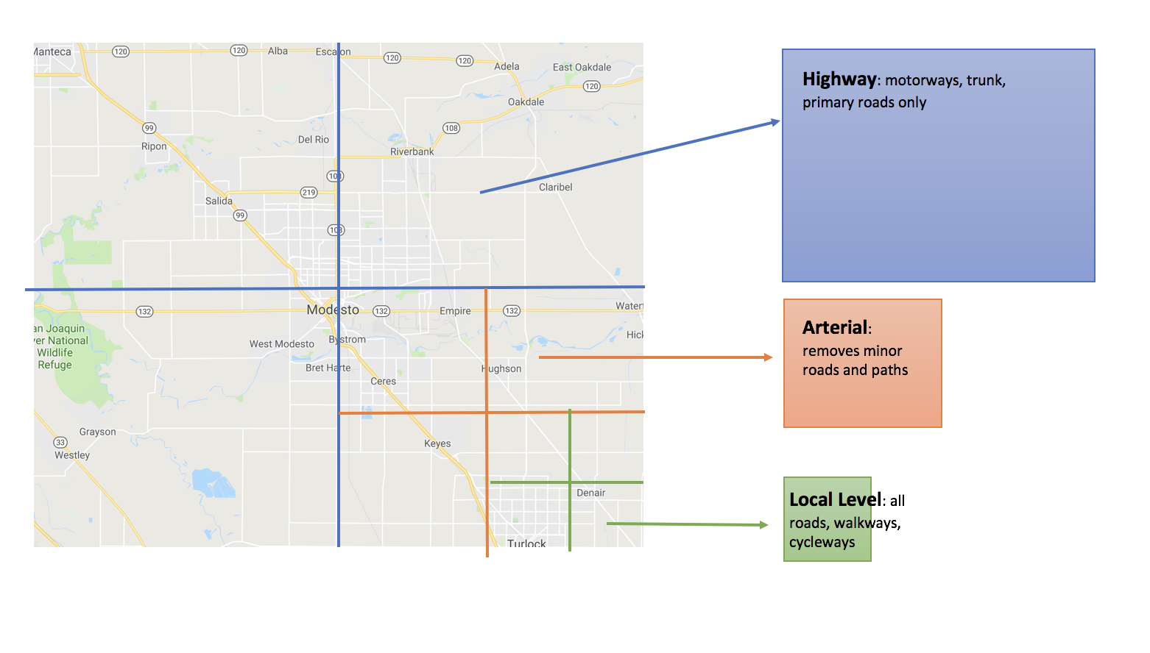
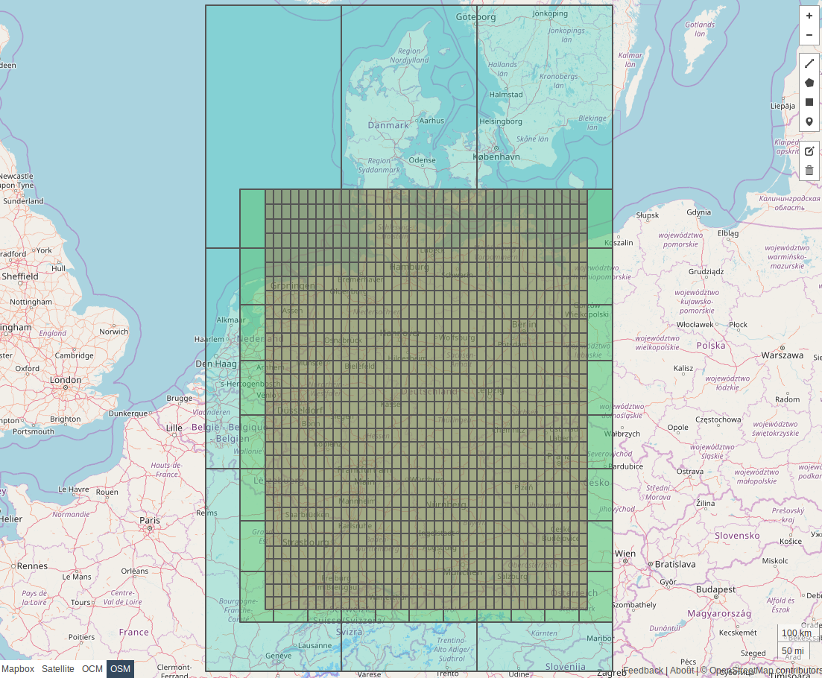
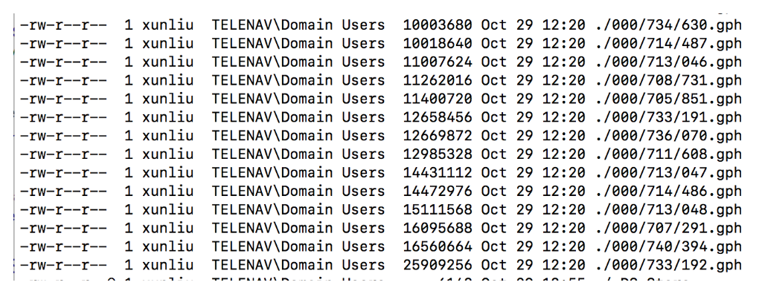
Valhalla Tiles
Fixed boundary tile
25MB

Slide 10
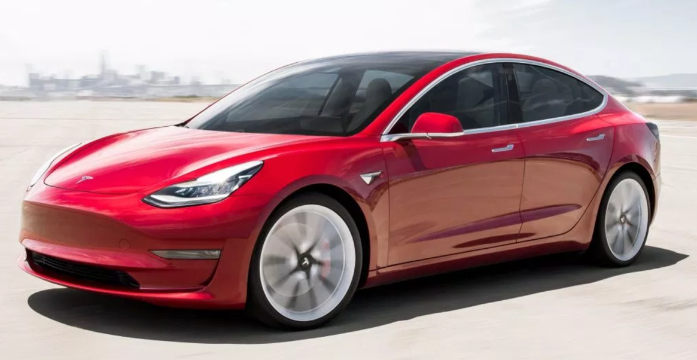
Lesson learned
Low level data organization affects feature tradeoff
Improvement on Current product
Fix boundary at space level, then try at tile level
Re-build boundary’s connectivity based on geometry and road names/type etc

Slide 11


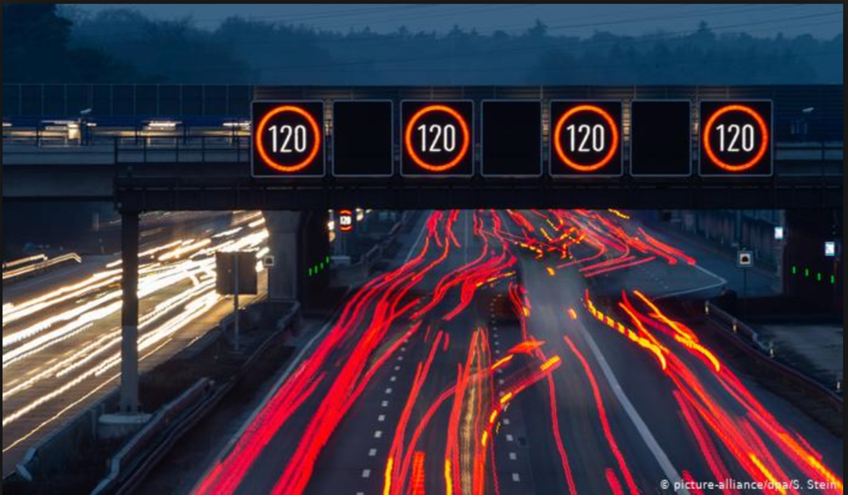
Story #2 Calculate route consider dynamic information

Slide 12
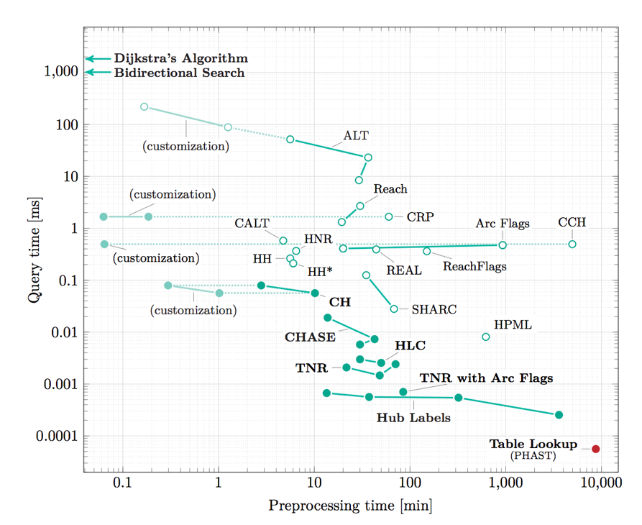
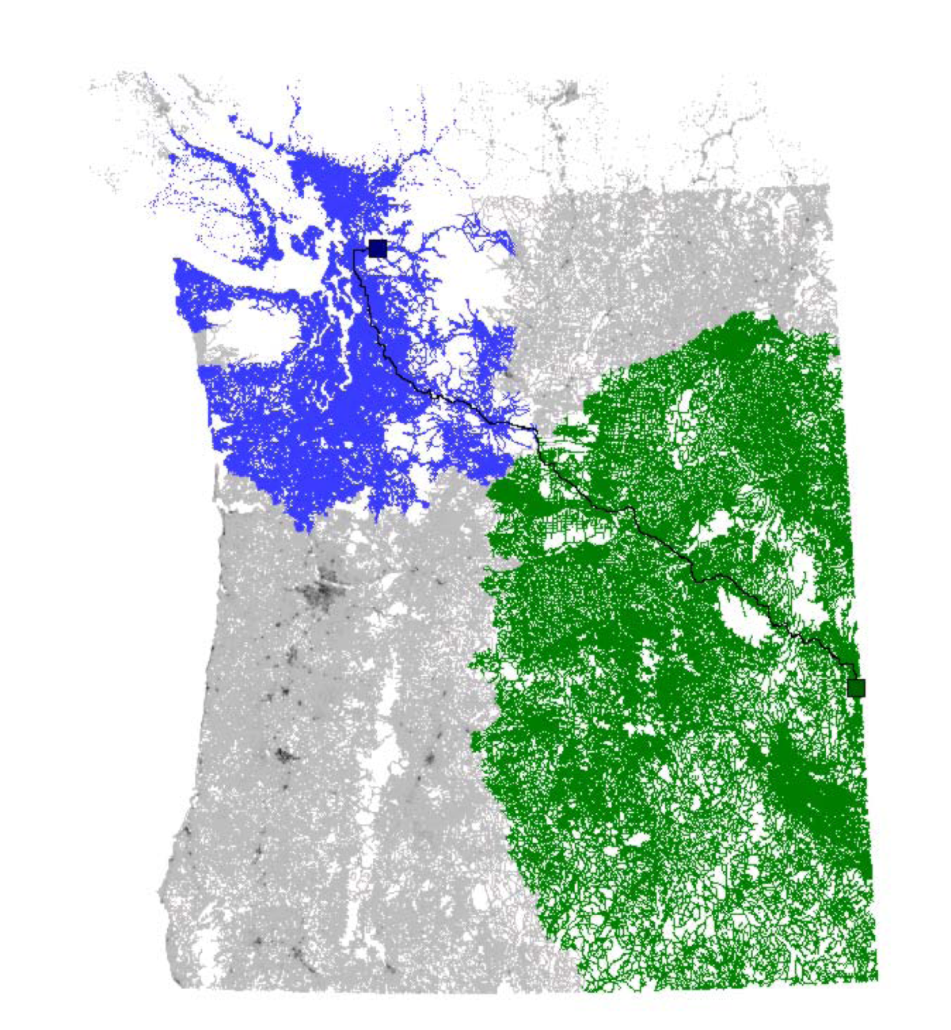
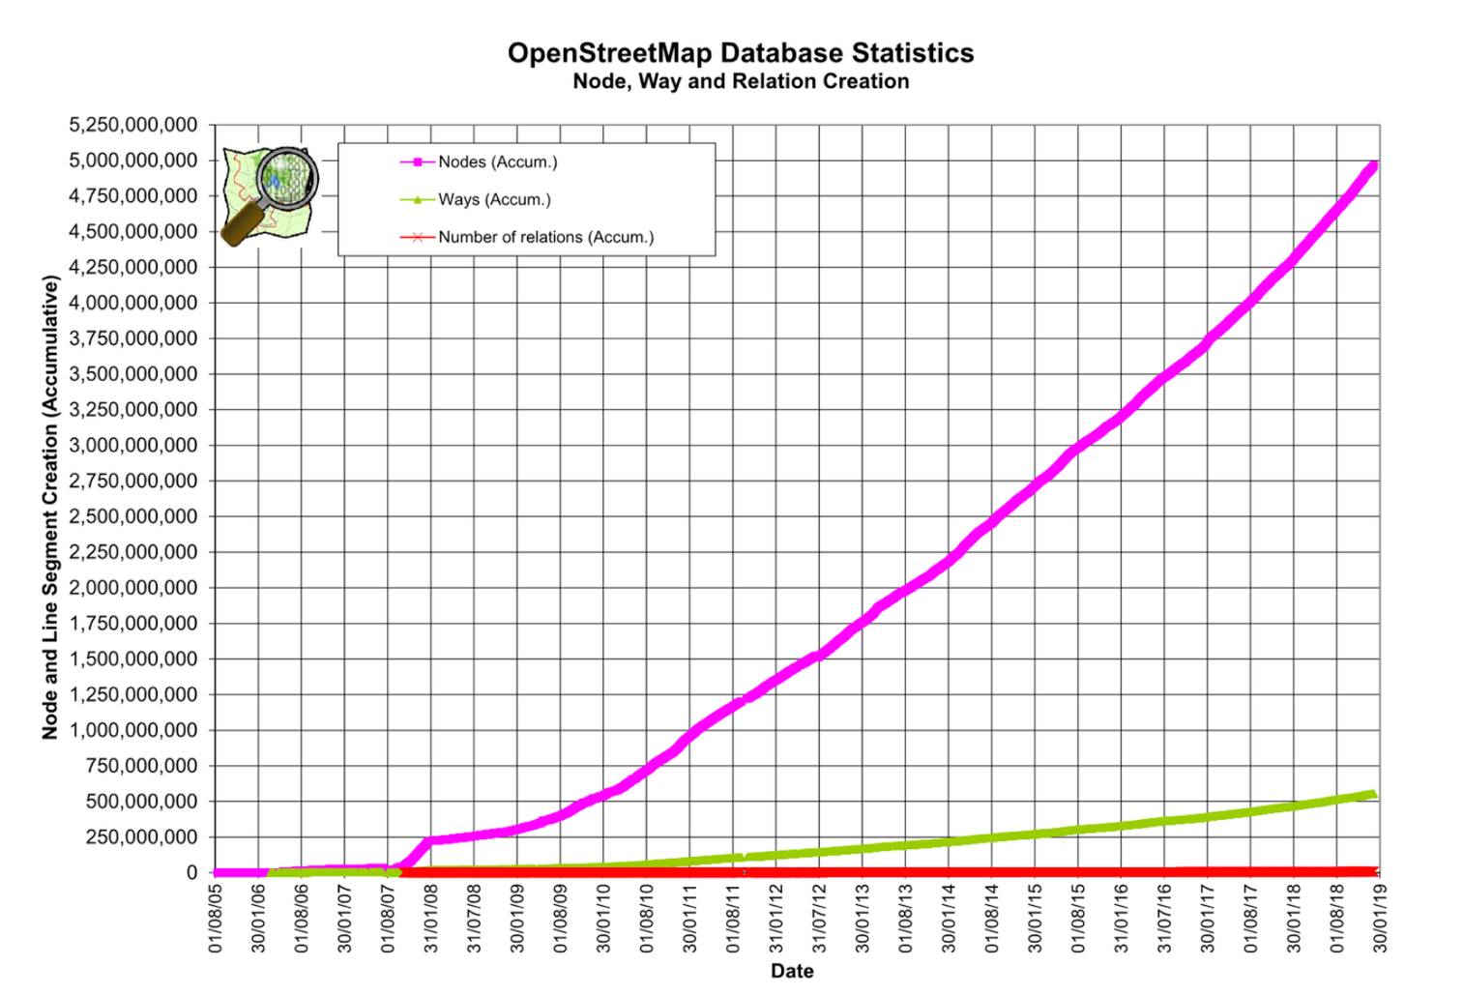
Story #2 Calculate route consider dynamic information
Chanllege of routing + dynamic information

Slide 13
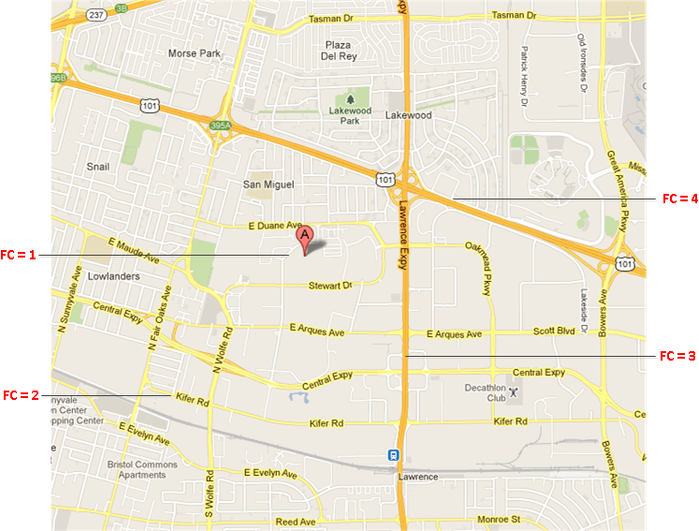
Function class Level promotion
FC value | Edge Count | Percent
1 | 38,342,700 | 81.63%
2 | 5,384,555 | 11.46%
3 | 1,810,361 | 3.85%
4 | 1,012,161 | 2.15%
5 | 417,404 | 0.889%
Total Edge Count | 46,967,181
Notes:
The original picture tells the feature of destination adjustment from Lyft

Slide 14
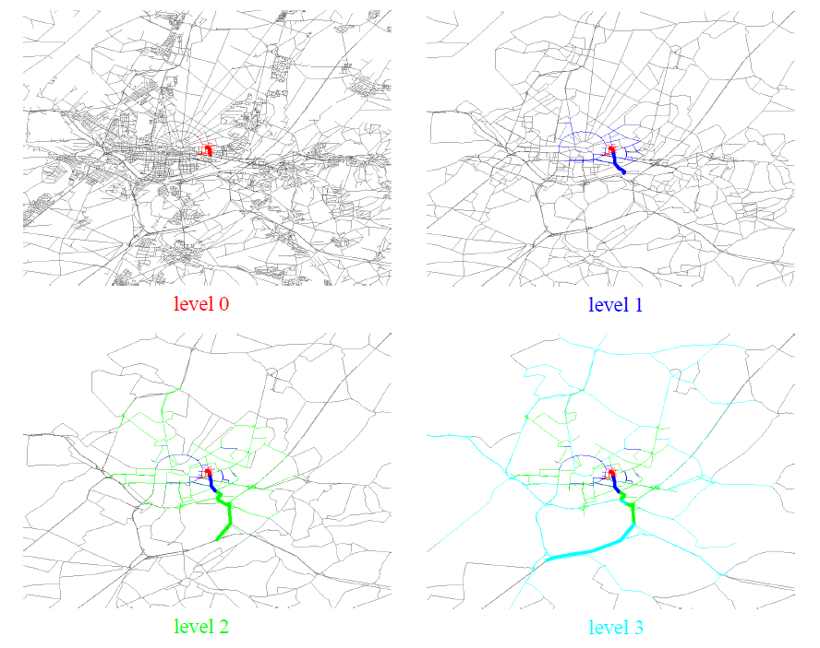
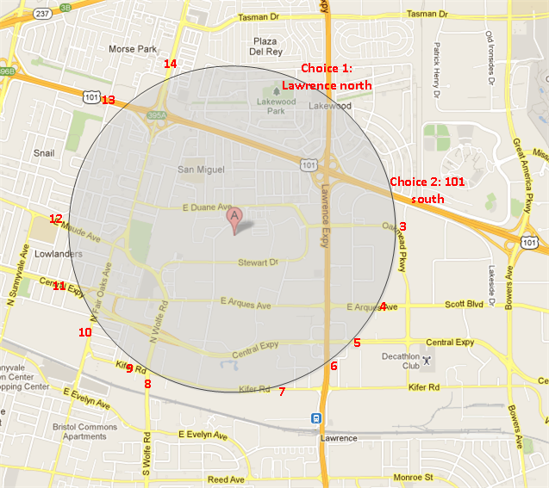
Function class Level promotion
Prune and Shrink
When to promote
Notes:
The original picture tells the feature of destination adjustment from Lyft

Slide 15
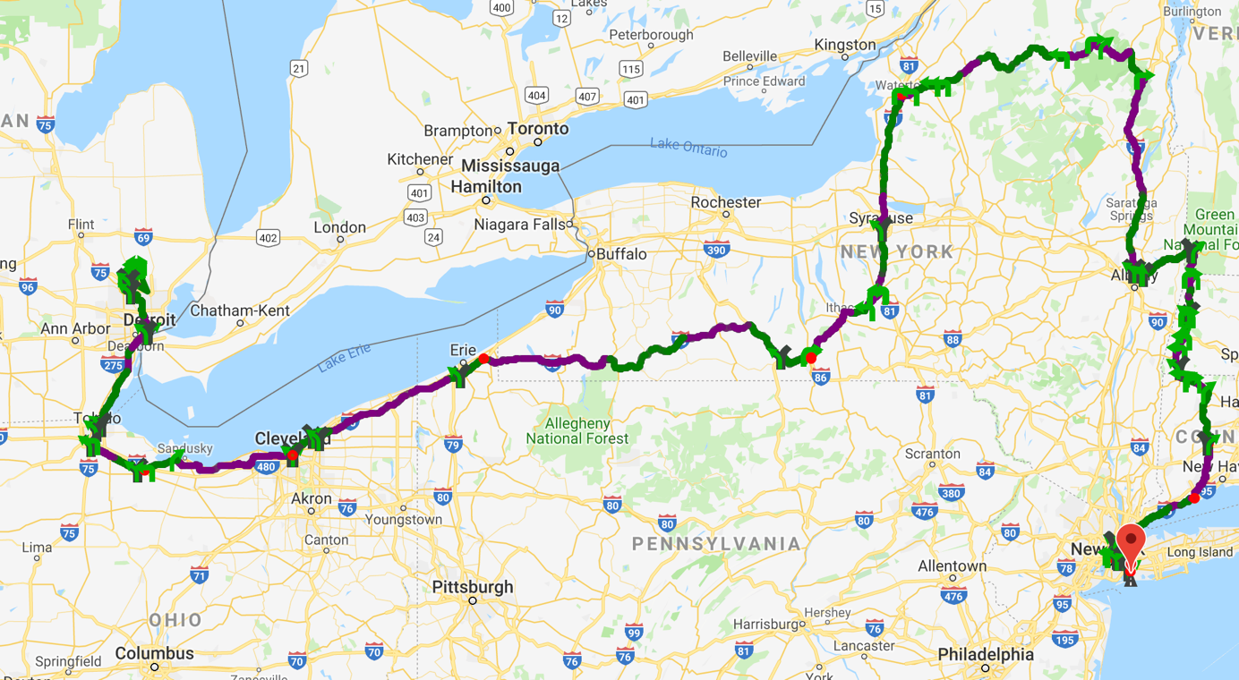
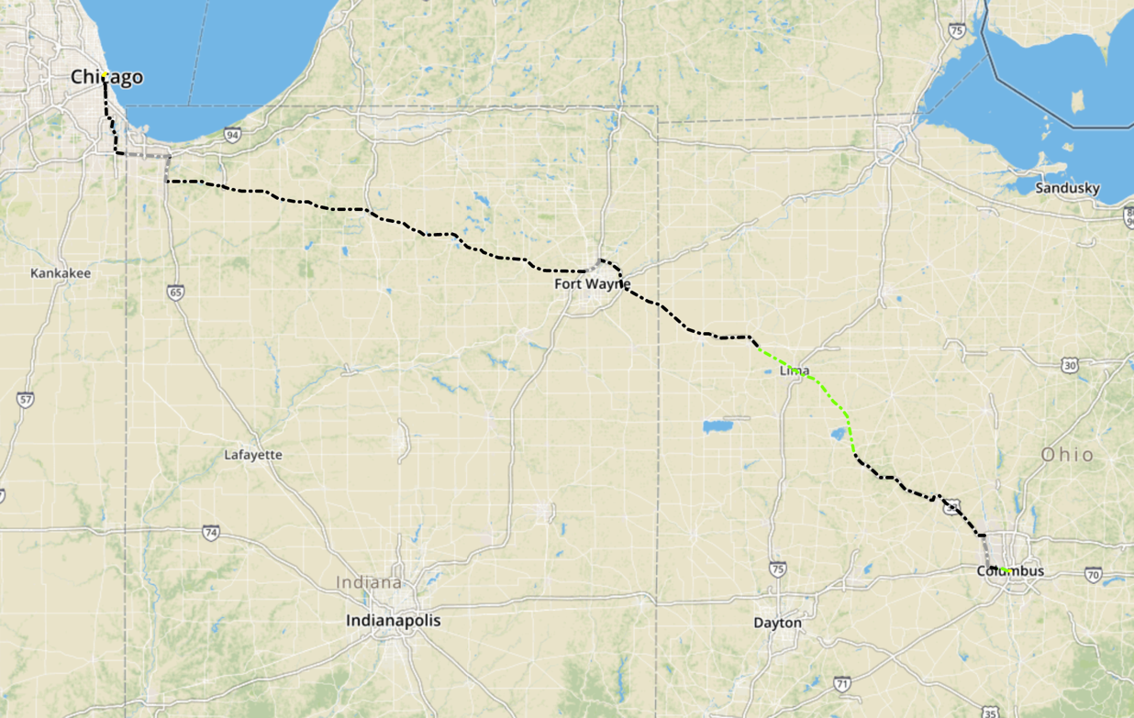
Function class Level promotion
Miss best candidate
Notes:
The original picture tells the feature of destination adjustment from Lyft

Slide 16
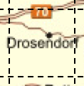
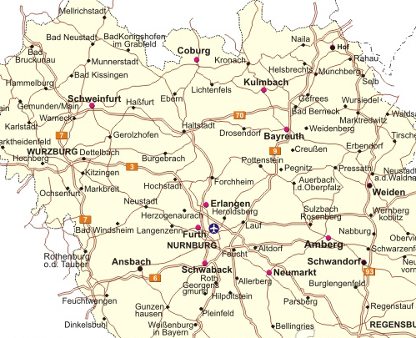
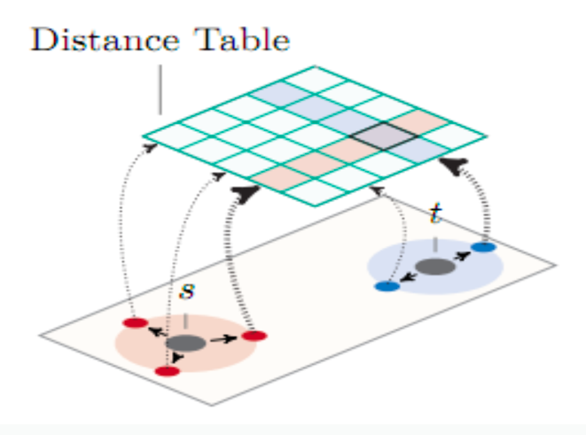
Partition the graph
Boundary edges
Boundary edges
By fixed size grid
Boundary edges
Notes:
The original picture tells the feature of destination adjustment from Lyft

Slide 17
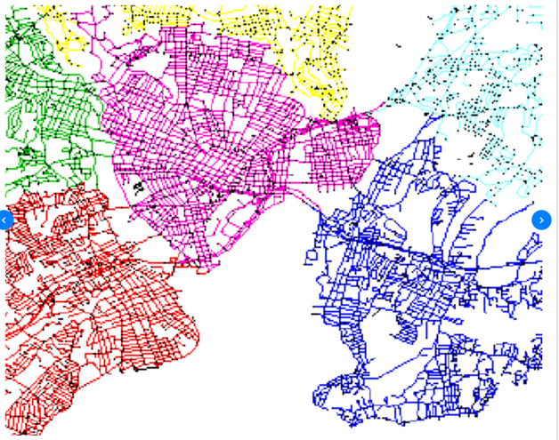
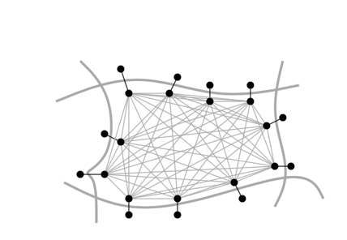
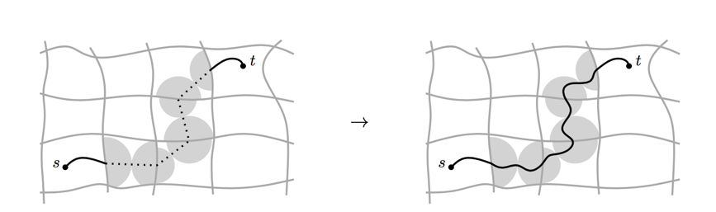

Customizable Route planning
Step 1: Metric independent preprocessing
Graph partition, preprocessing, hours
Step 2: Customization
Apply dynamic information with cost model
Each round of traffic update, seconds
Step 3: Query
Real time, per request, mili-seconds
Notes:
The original picture tells the feature of destination adjustment from Lyft

Slide 18
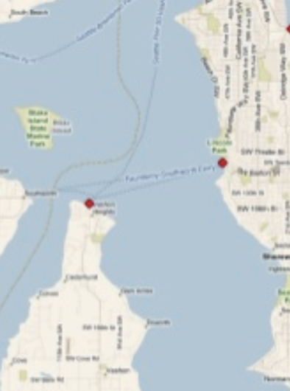
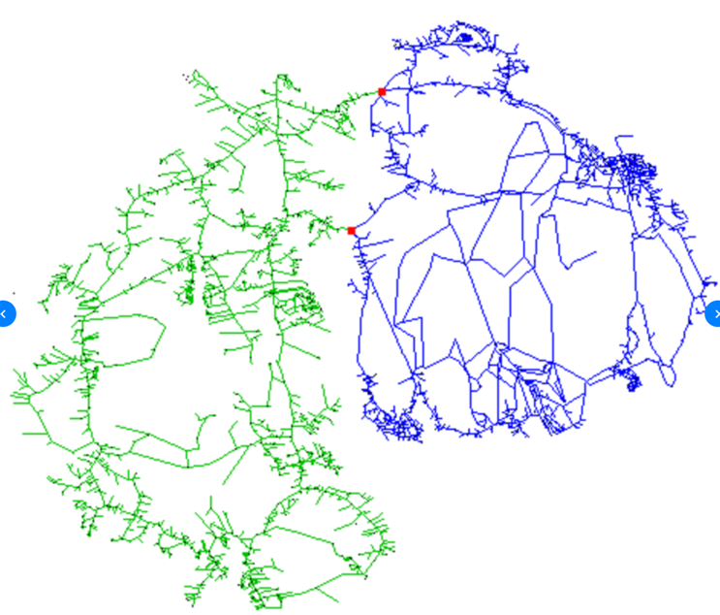
How to find min-cut
Notes:
The original picture tells the feature of destination adjustment from Lyft

Slide 19
How to find min-cut

Slide 20
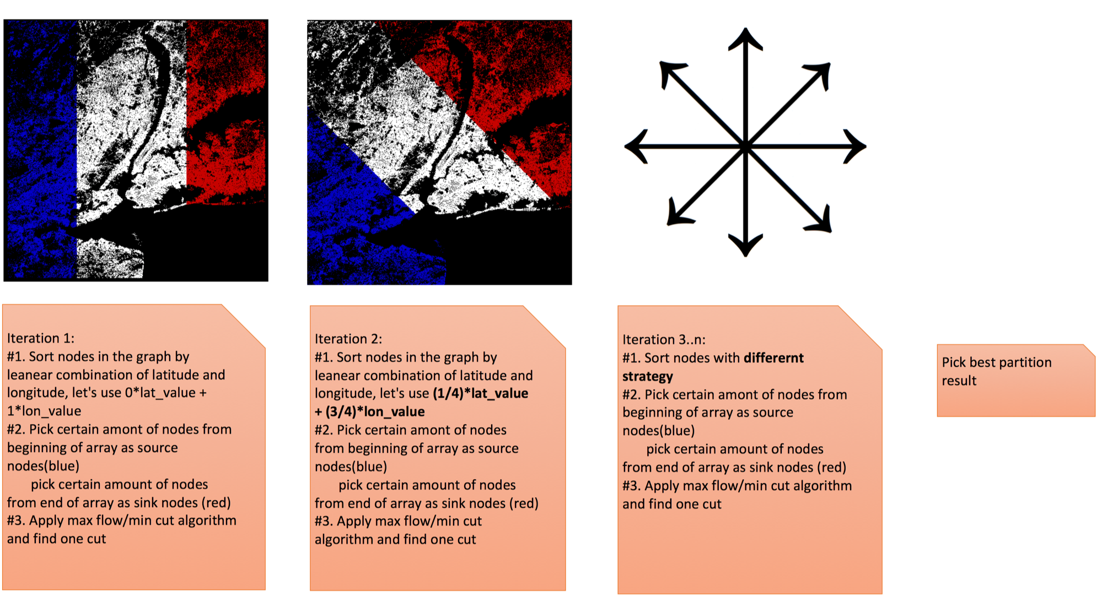
How to find min-cut

Slide 21
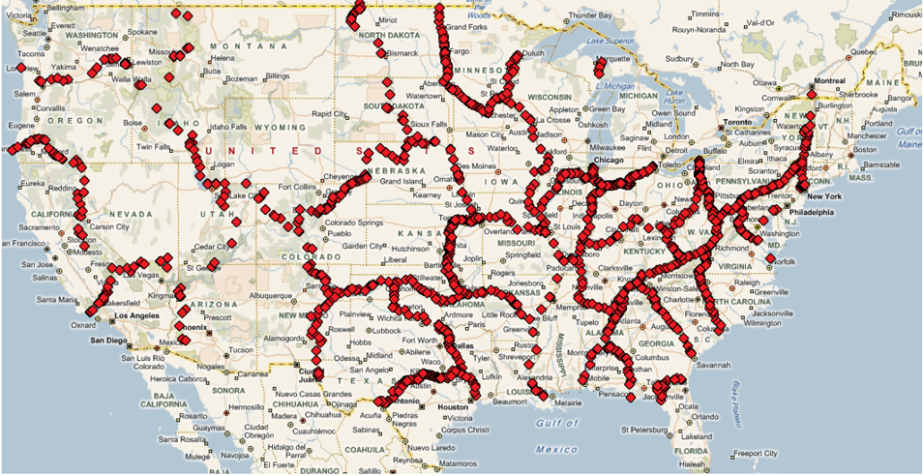
Cut result of US
Notes:
Picture come from the paper of PUNCH

Slide 22

Lesson learned
Cloud side could use different strategy compare with embedded side
Accurate algorithm matters especially for ML
Improvement on Current product
Divide and conquer
Everything hide behind API
Docker/Lua/Cucumber

Slide 23
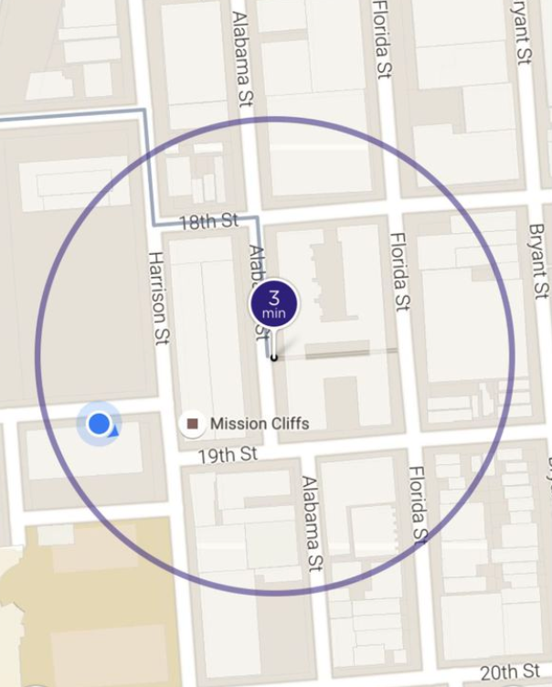
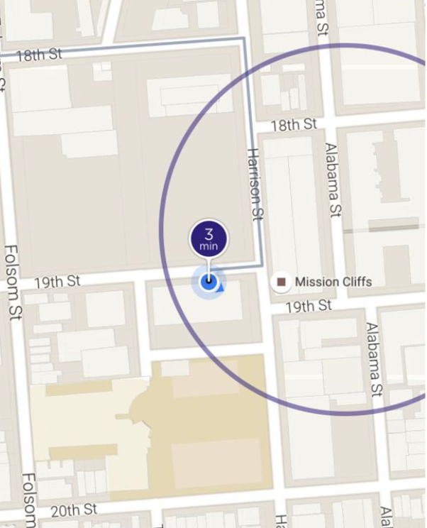
Story #3 Map Matching when the map data is wrong
A story about Lyft pick up
When Map data exists
No Map data
Notes:
The original picture tells the feature of destination adjustment from Lyft

Slide 24
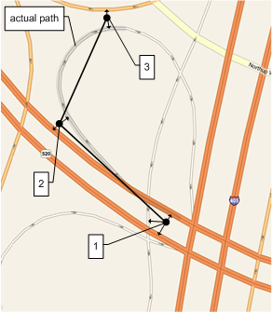
Offline Map Matching
What/How/Why
Give a sequence of GPS signals, find the most probable sequence of road segments

Slide 25
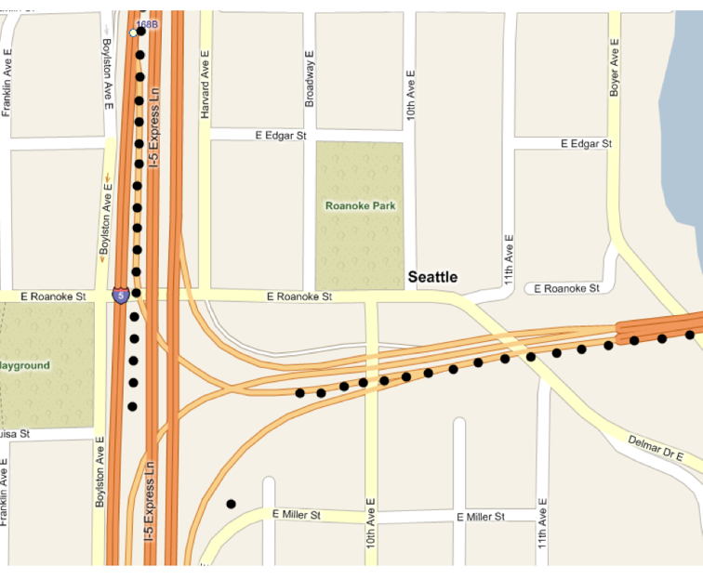
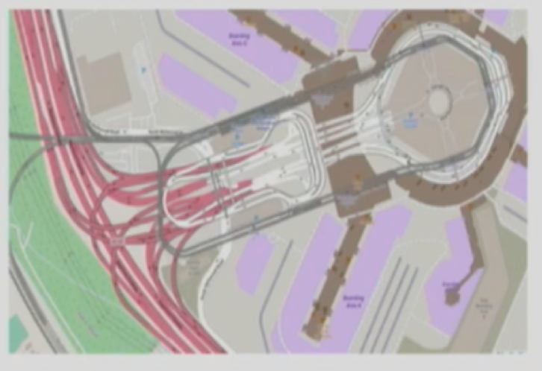
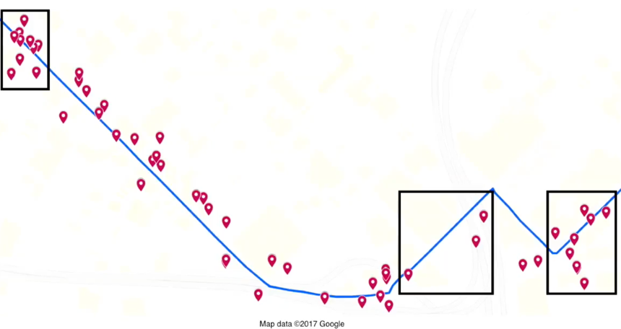
Offline Map Matching
What/How/Why/
Noise & Sparseness
Missing GPS
Wrong/Complex Map Data

Slide 26

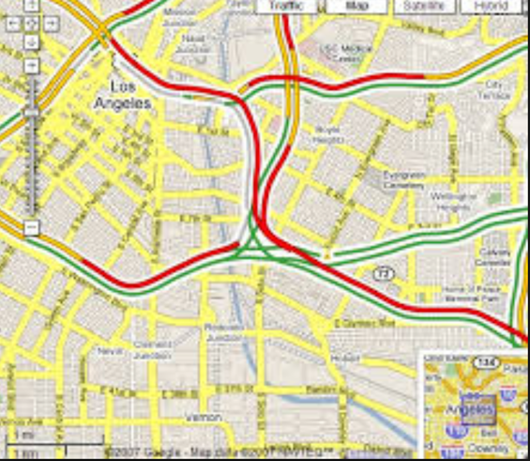
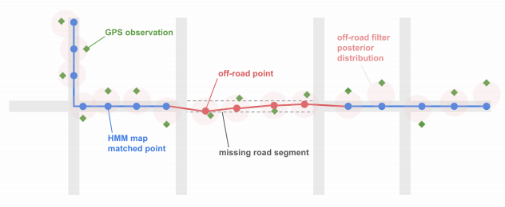
Offline Map Matching
What/How/Why
Historic/Live traffic/ETA
Enhance map data
User pattern
Notes:
Live traffic
Enhance map data
Analysis user pattern

Slide 27

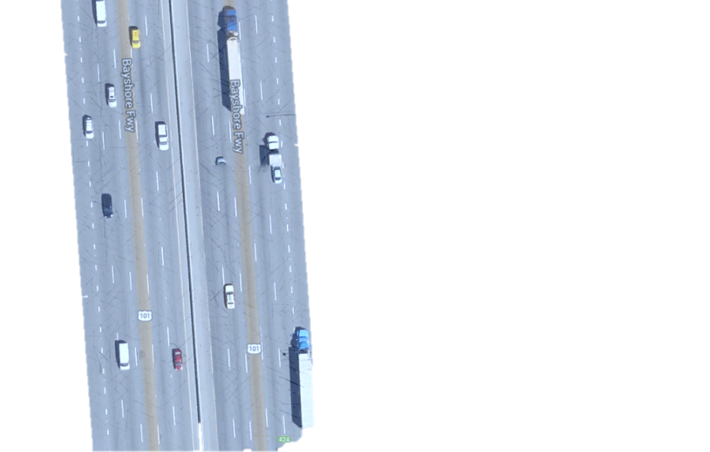
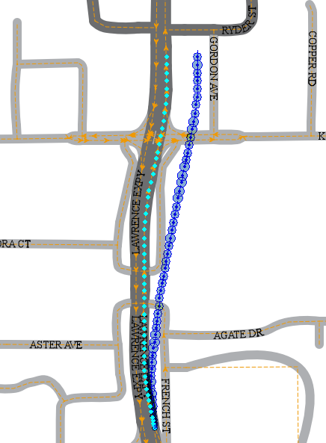
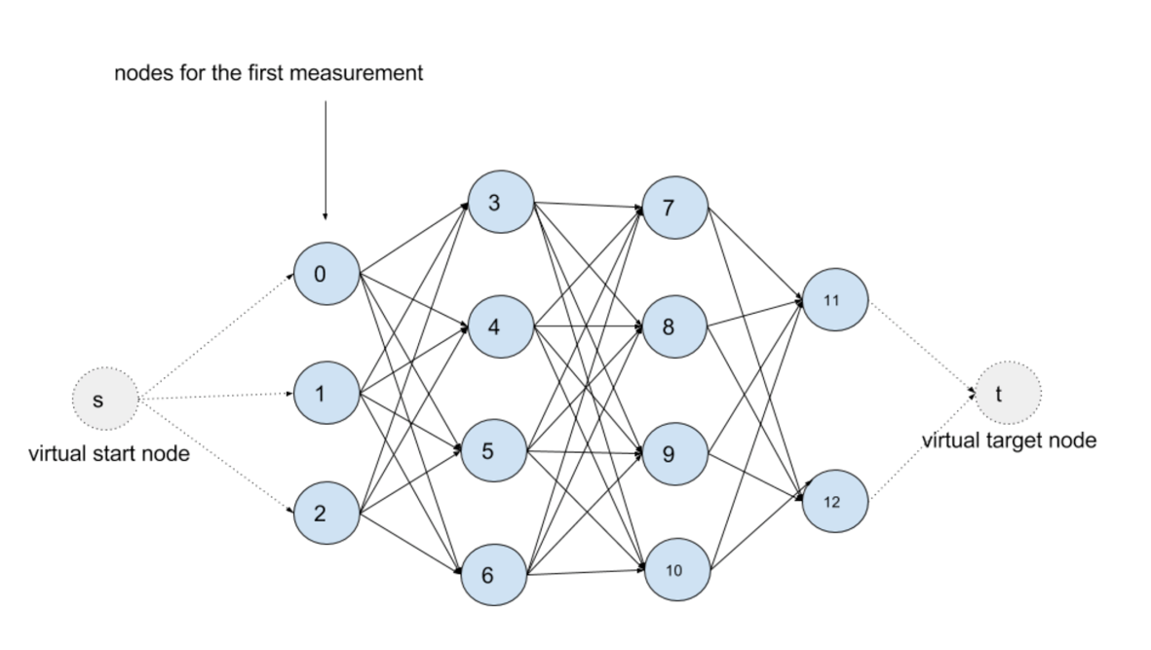
Map Matching logic
Lifecyle
Filter noise points
Find Nearest edges as Candidate
Consider Connectivity
Optimal path
99% (2.05*errsize)
Kalman Filter
95% (1.65*errsize)
67% (1.00*errsize)
Emission Probability
MM Fix
DR Fix
Road Width
dmin
Transition Probability
Viterbi Algorithm
Hidden Markov Map Matching

Slide 28
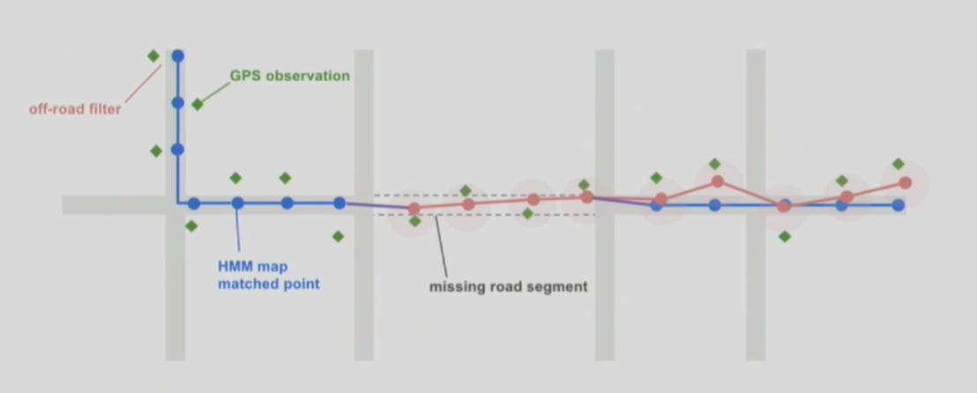

When map is wrong (LYFT’s way)

Slide 29


Lesson learned
Active open source community keeps your technical up to date
The unique and valuable data makes your business win

Slide 30
When map is wrong (LYFT’s way)

